Slide 1
Modeling Stream Preprocessing with WebGME
Xingyu Zhou
Electrical and Engineering Department
Vanderbilt University
zhouxingyu319@gmail.com

Slide 2
Key words
stream computing;
Amazon Kinesis;
task scheduling;
WebGME;
modeling;

Slide 3
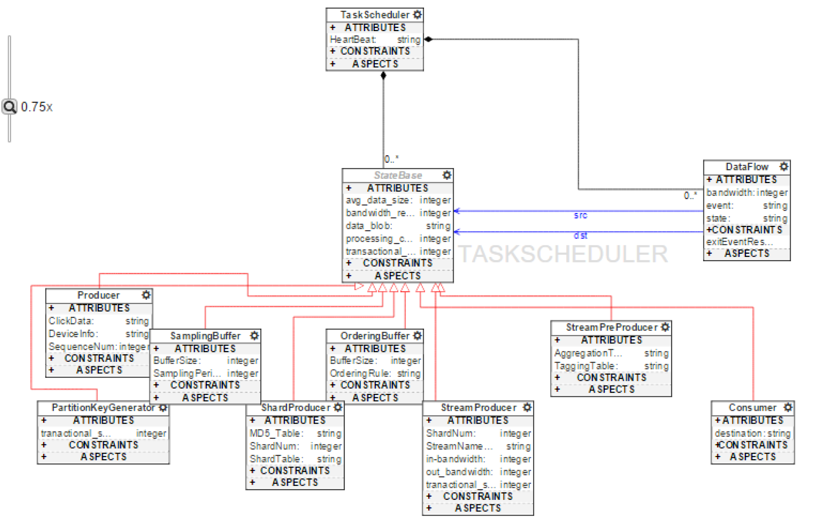
metamodel

Slide 4
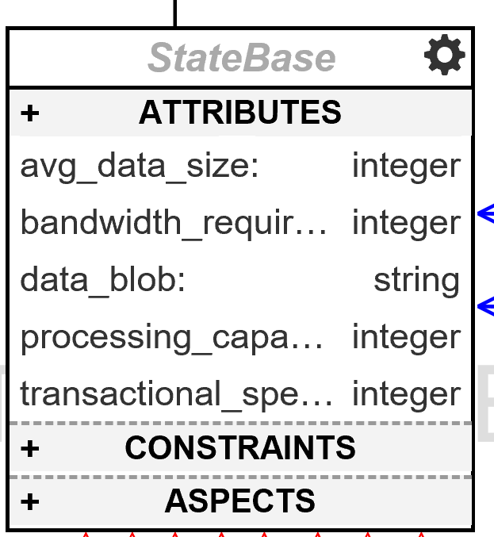
states
Fundamental States:
Producer
Sampling buffer
shard producer
ordering buffer
stream producer
application

Slide 5
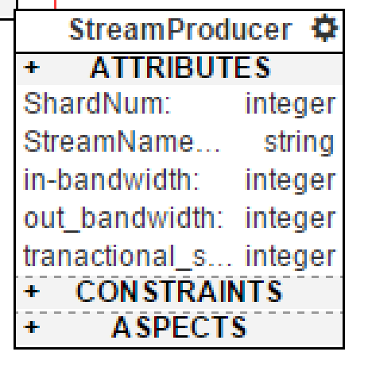
Stream producer
Shard num is automatically calculated out by the model

Slide 6
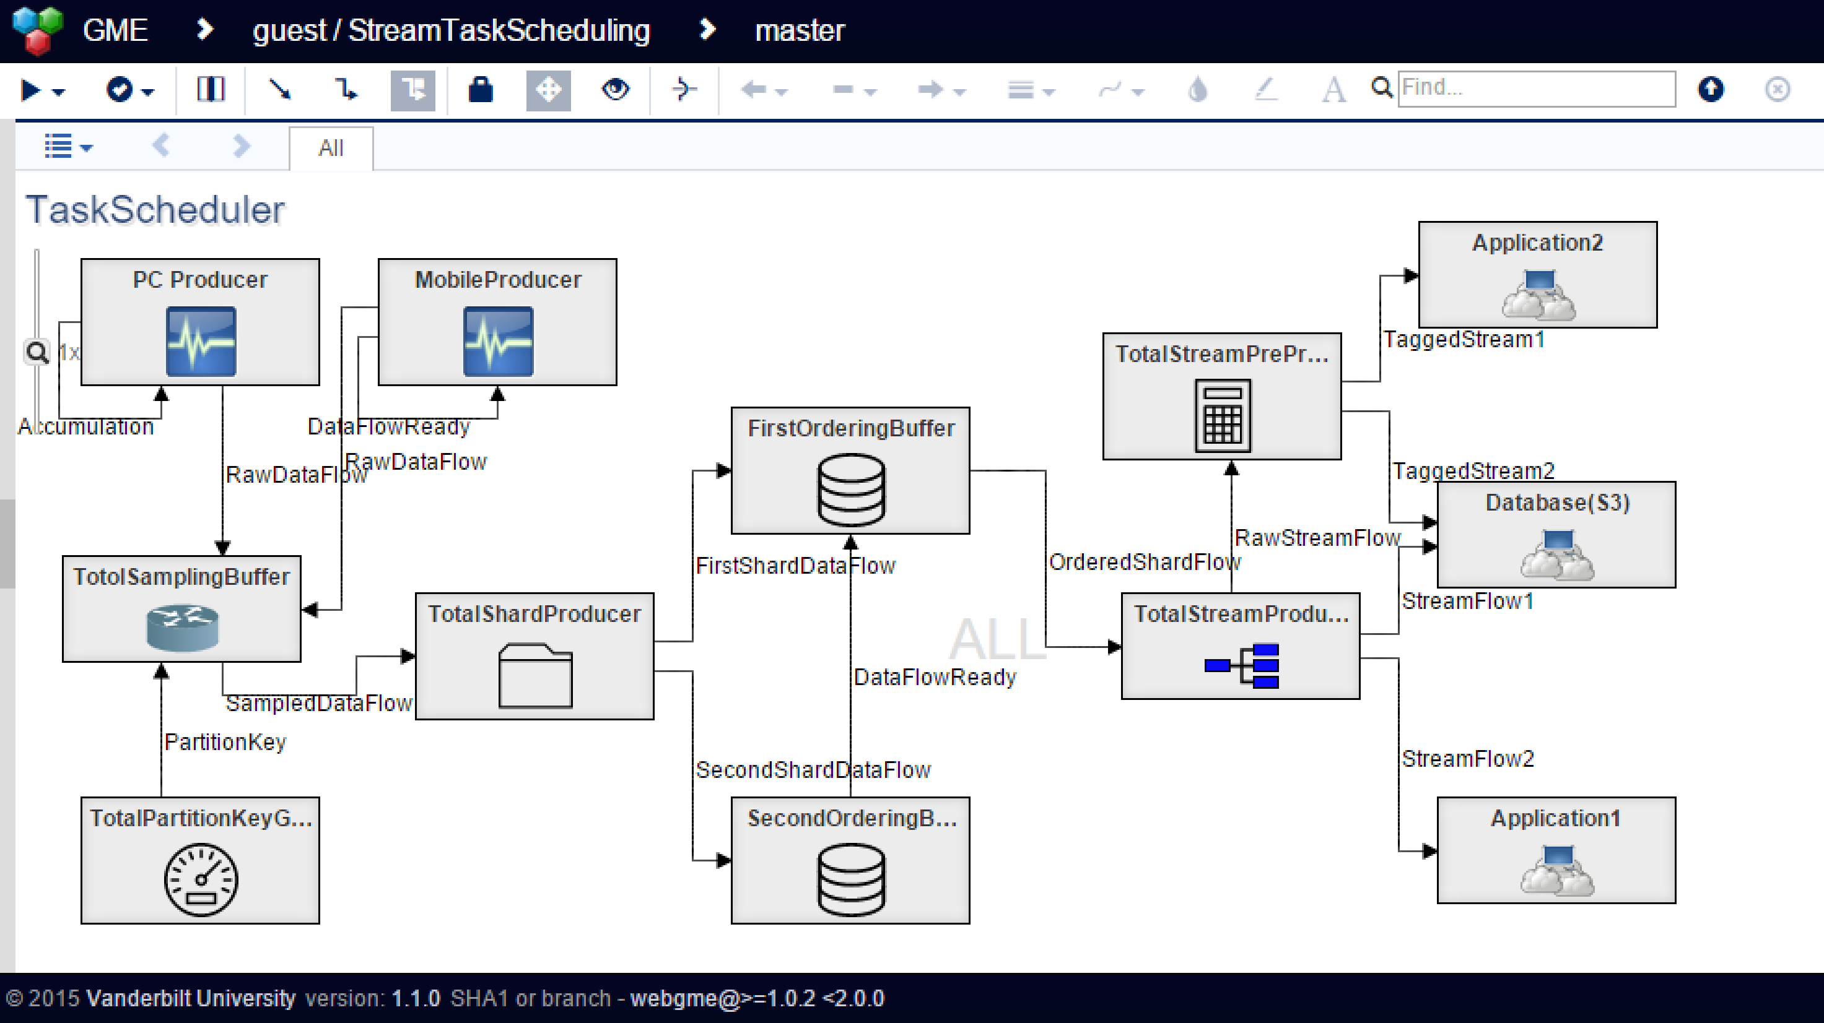
Model instance
Multiple producers
Multiple applications
More than one buffers

Slide 7
network Optimization Interpreter
Capacity checking
Shard num decision
number_of_shards
=max(incoming_write_bandwidth_in_KB/1000, outgoing_read_bandwidth_in_KB/2000)

Slide 8
output
"improvements": [
"processing_capacity",
"bandwidth_requirement",
{
"shard_num": 1000
}
]

Slide 9
summary
A simple method to model&optimize the stream preprocessing
Gap between configuration&realization

Slide 10
Q&a time

